Slide 1
CSE 11 Accelerated Intro to Programming Lecture 12
Greg Miranda, Spring 2021
This lecture is being recorded

Slide 2
Announcements
Quiz 12 due Monday @ 8am
PA4 due Wednesday @ 11:59pm
Survey 4 due tonight @ 11:59pm
PA1 Resubmission due tonight @ 11:59pm
Week 6, 9, and finals week for take-home exams

Slide 3
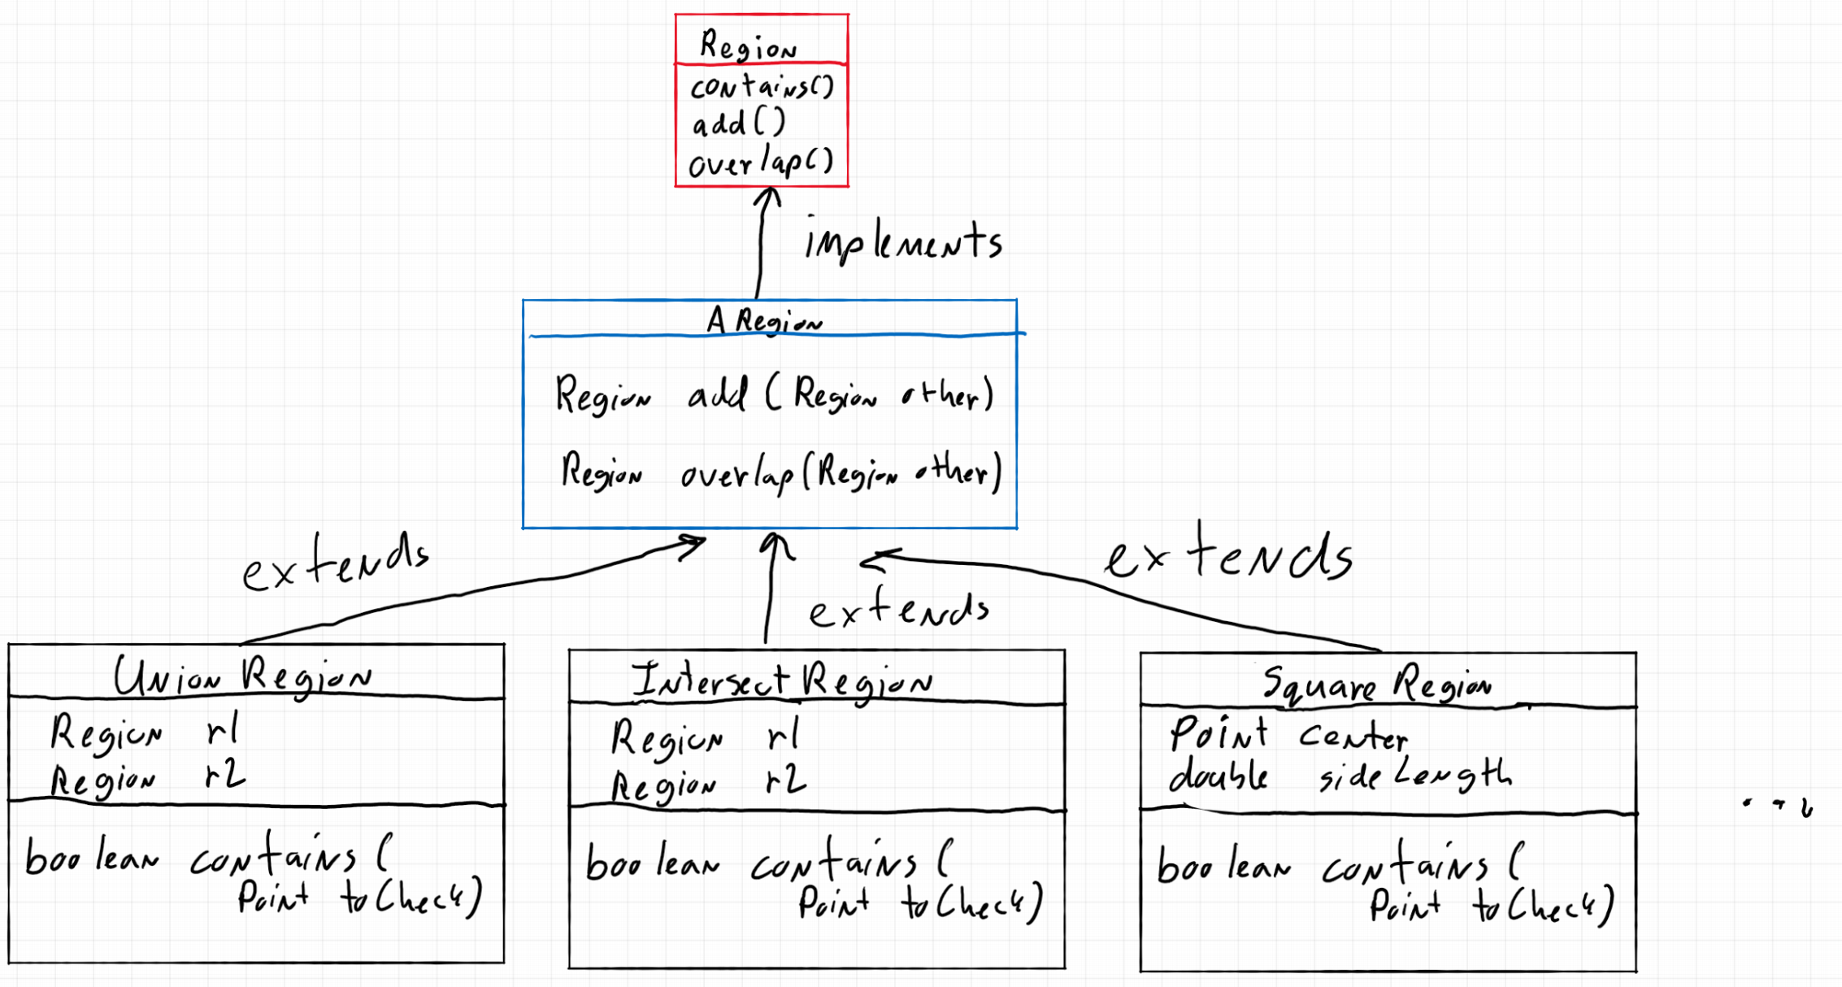
Class Hierarchy Diagram

Slide 4
Abstract Class
Why did we introduce abstract classes?
Multiple classes had the exact same method
Same method header (same types)
Same implementation
add() method – put into all the region classes
Same implementation in all of them
Made an abstract class
Had one implementation of that method
Used extends so that all of the implementations could share that one method

Slide 5
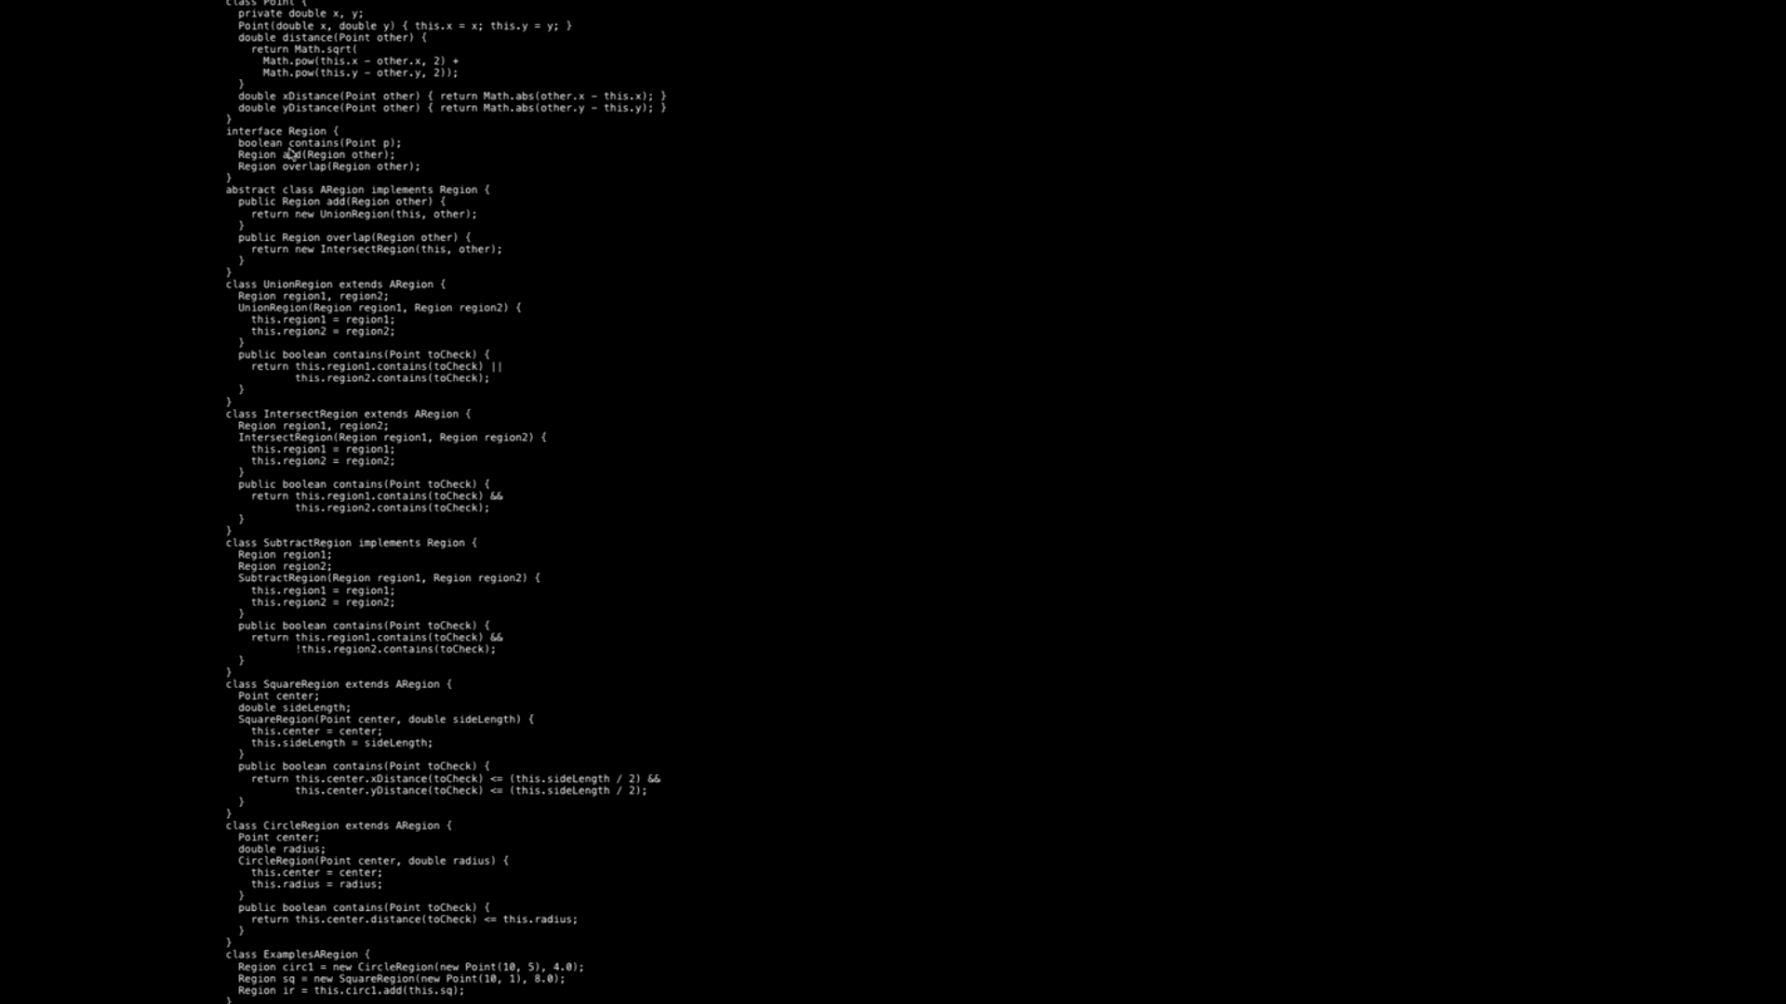

Slide 6
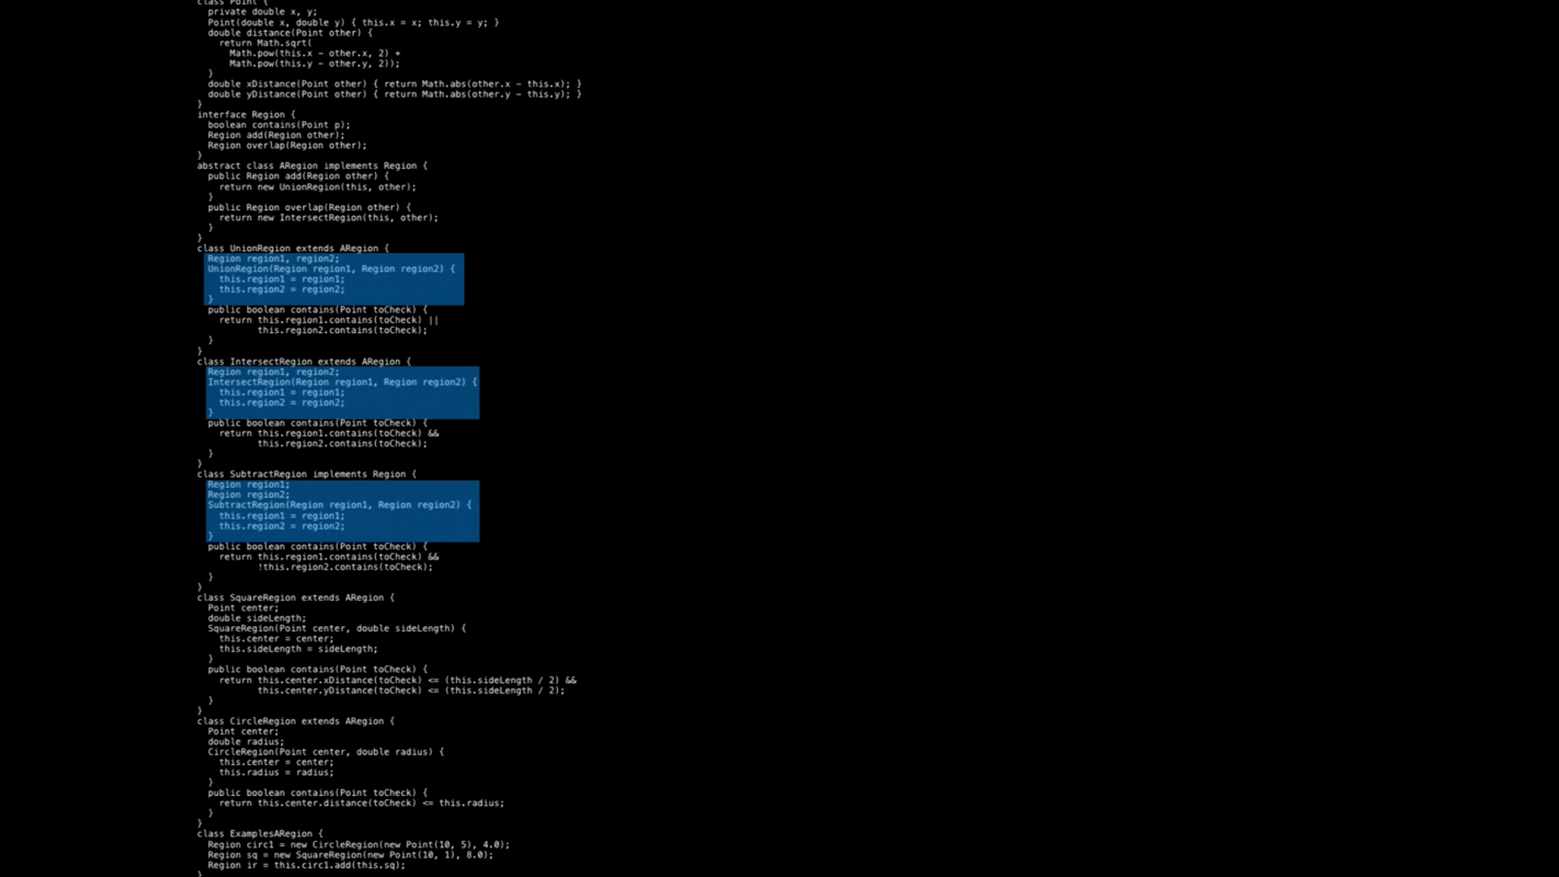

Slide 7
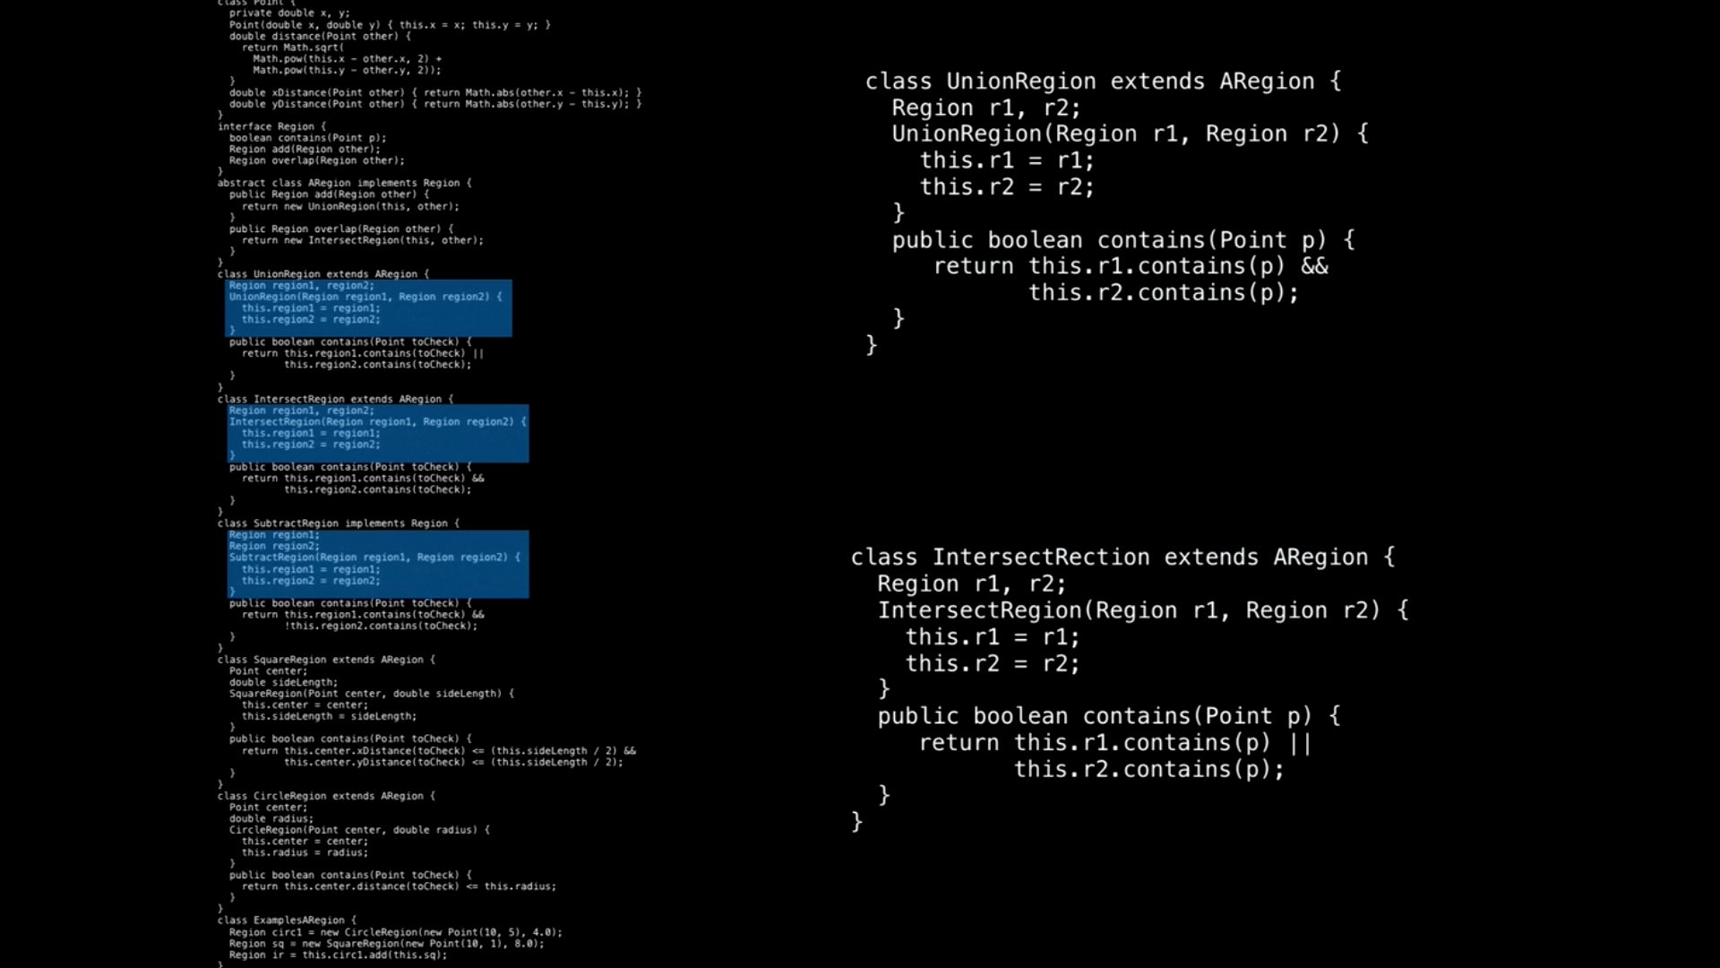

Slide 8
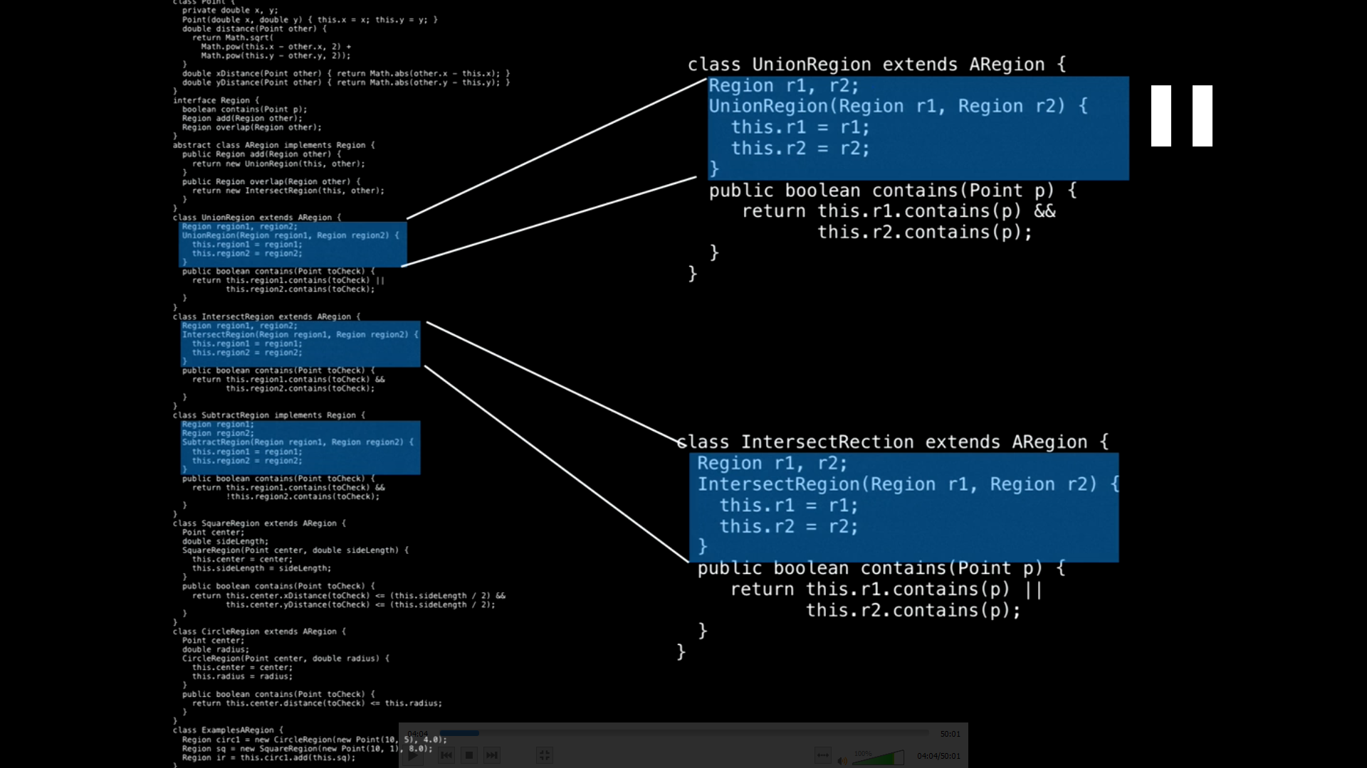

Slide 9
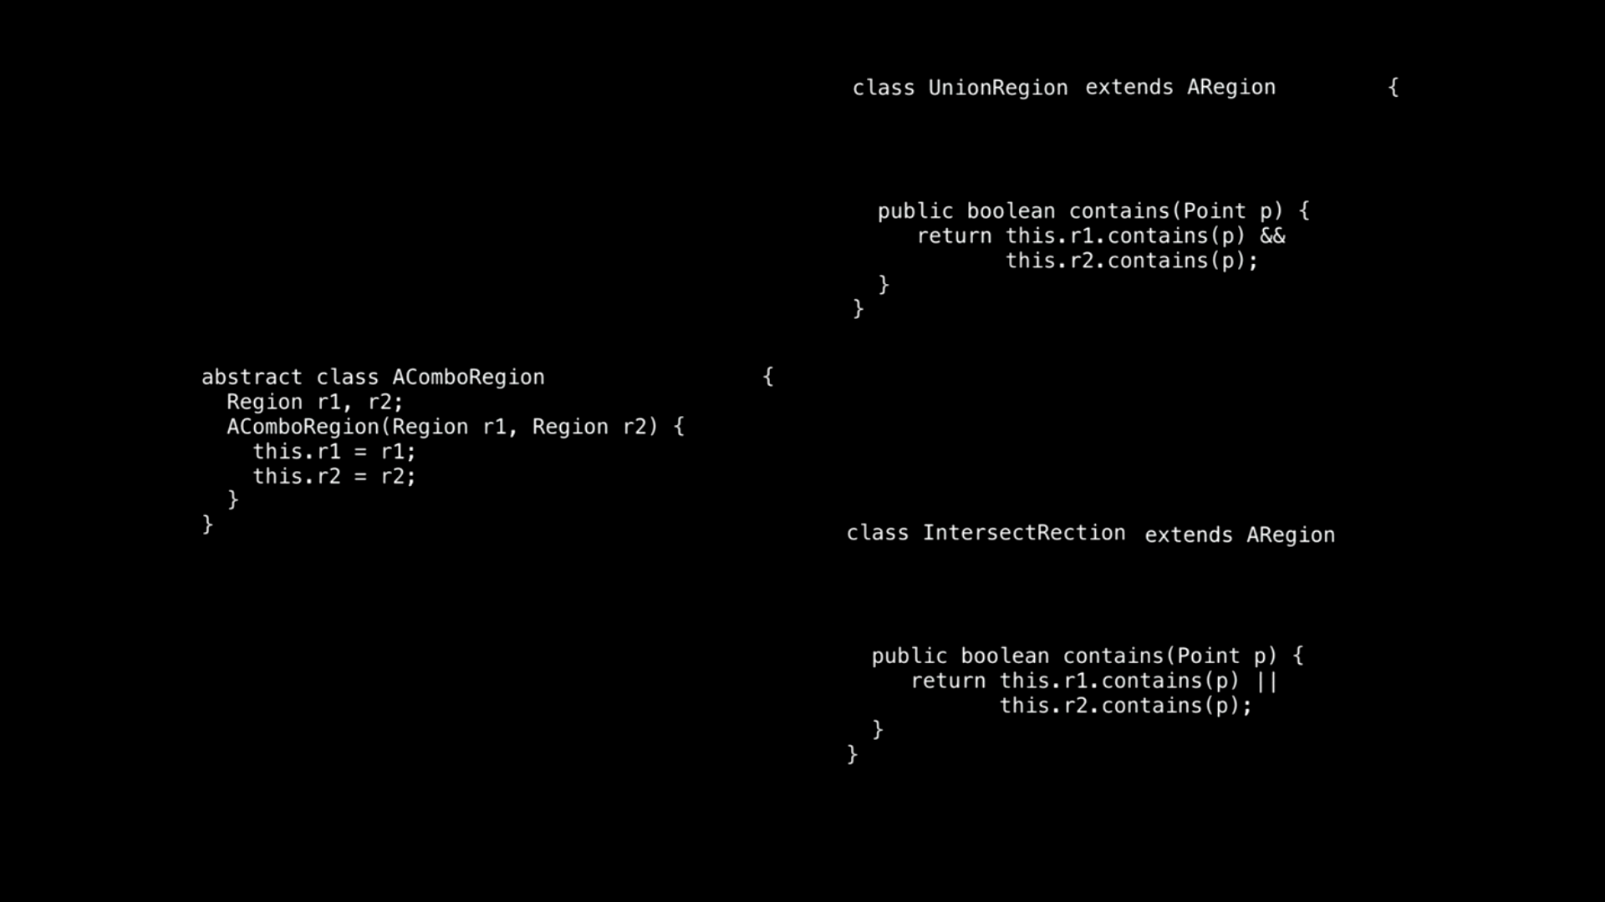

Slide 10
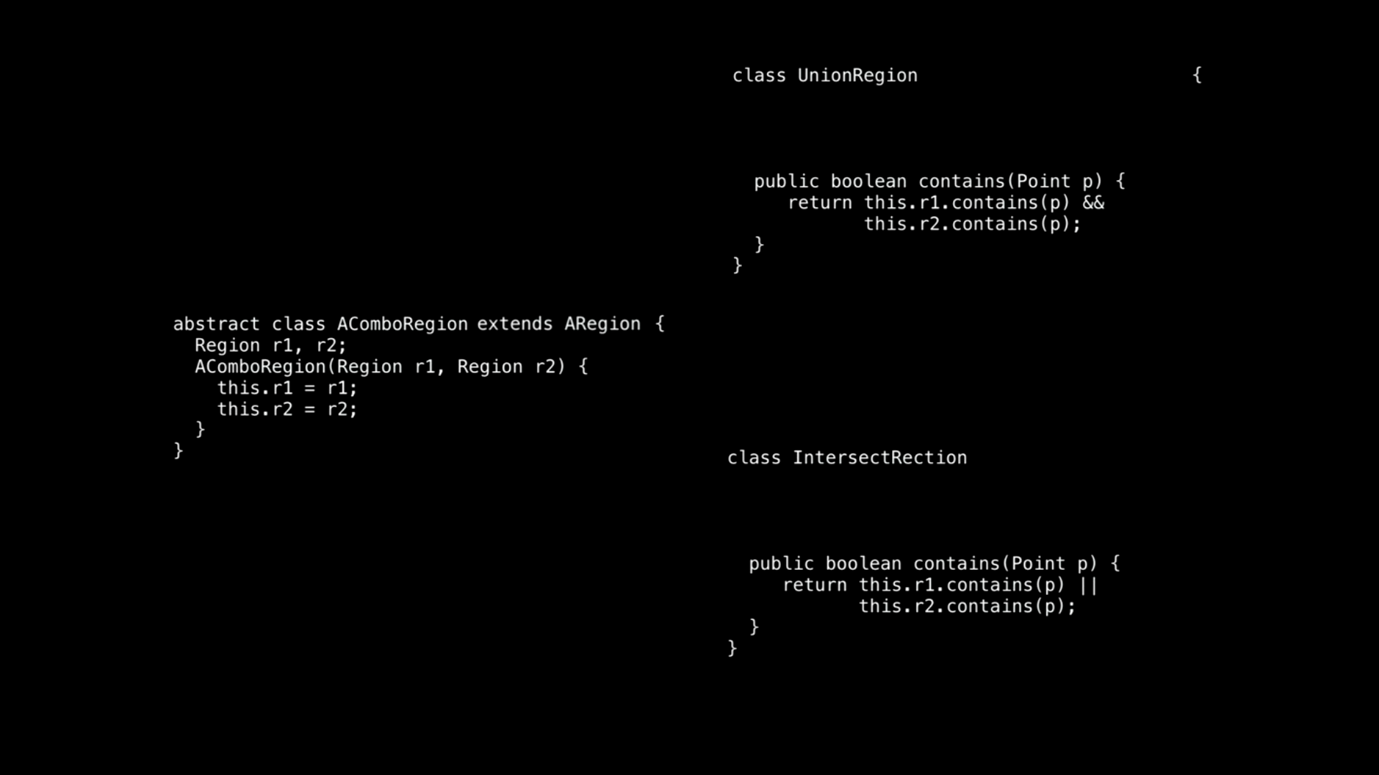

Slide 11
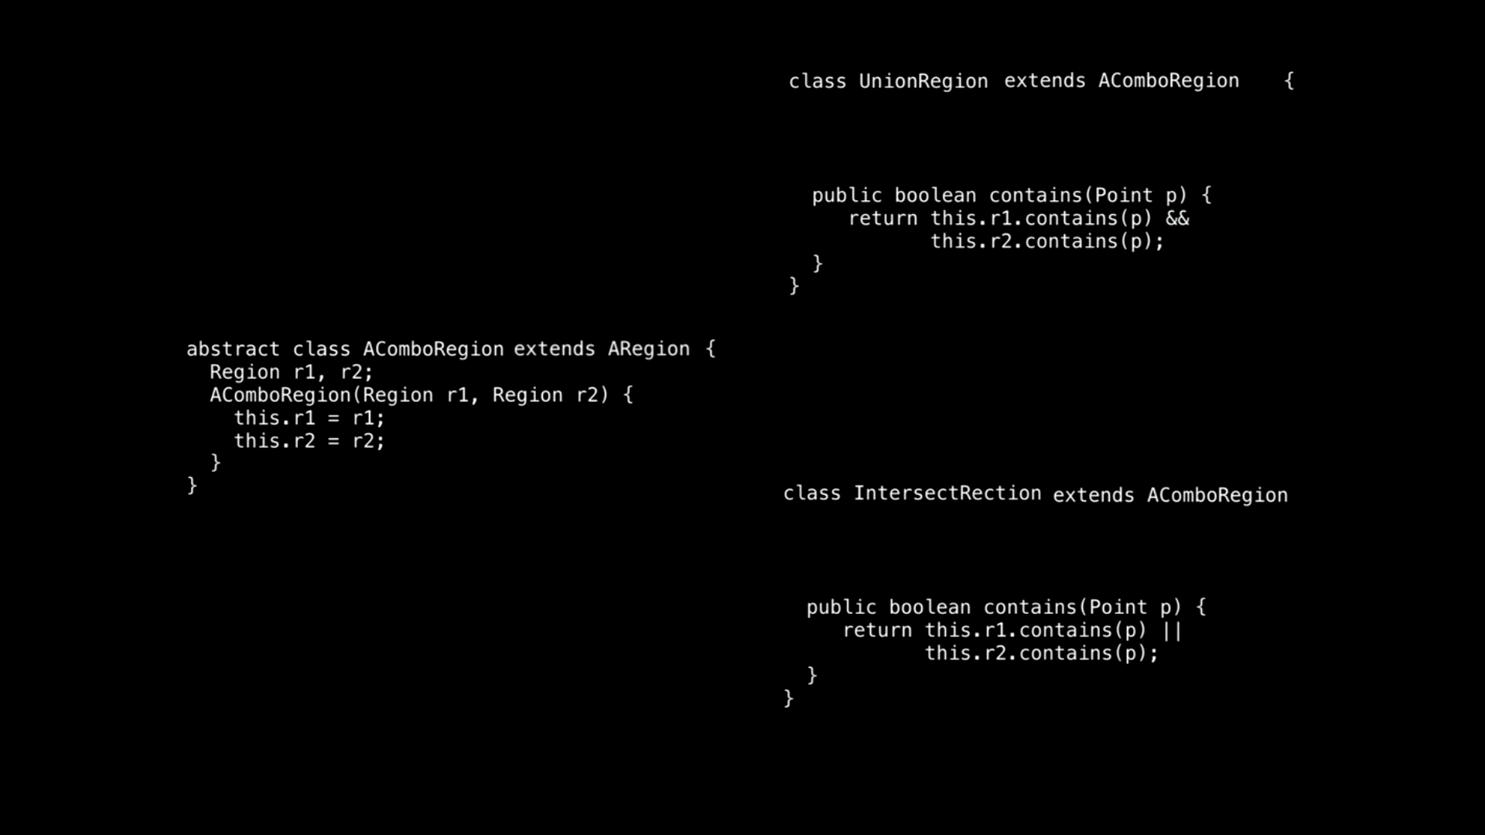

Slide 12
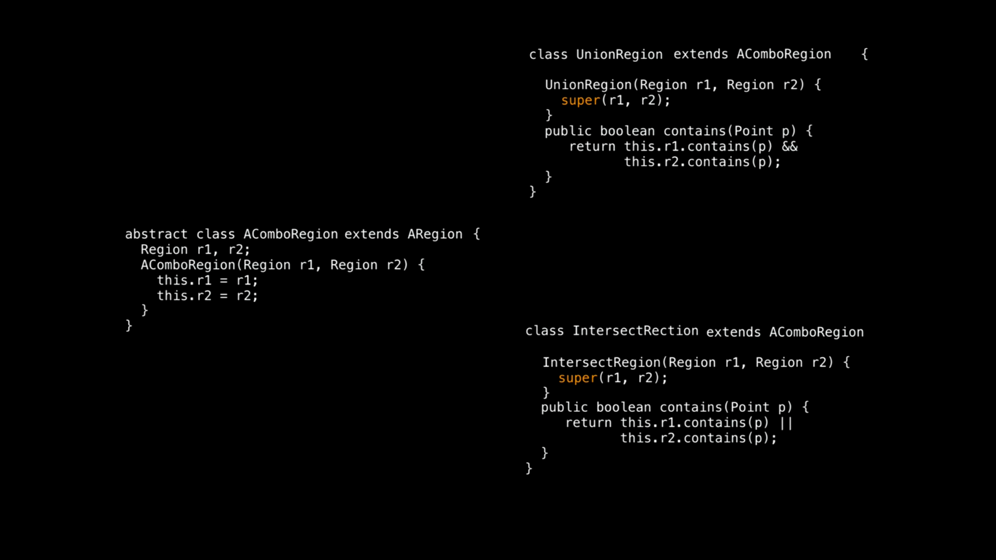

Slide 13
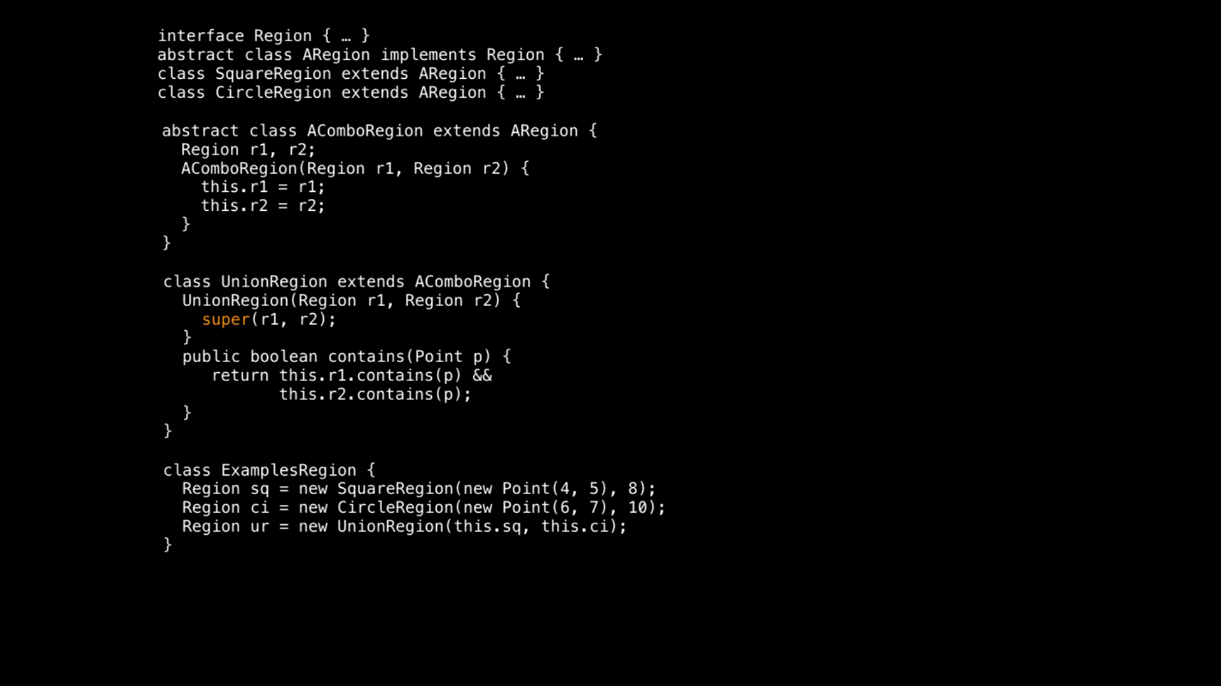

Slide 14
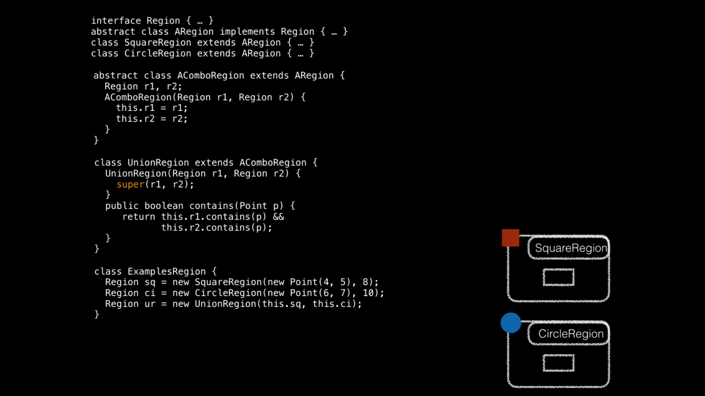

Slide 15
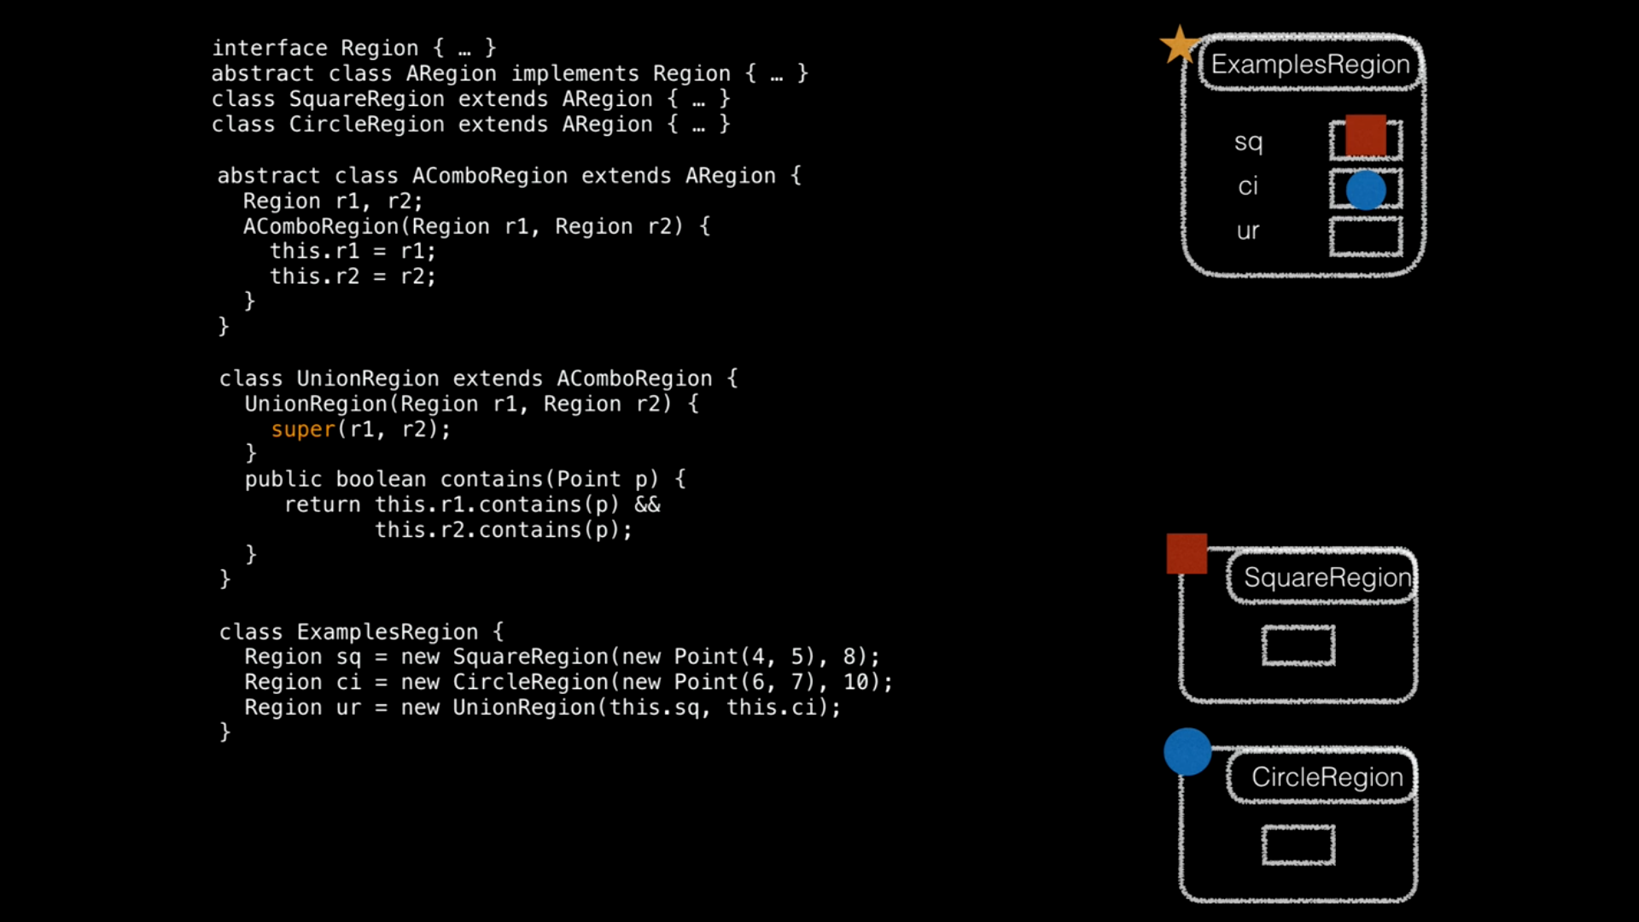

Slide 16
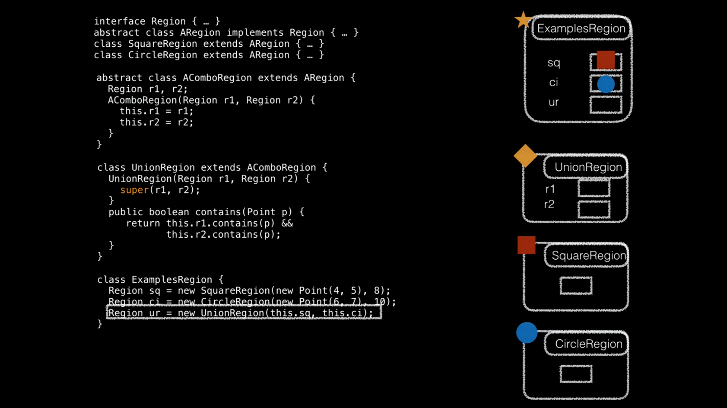

Slide 17
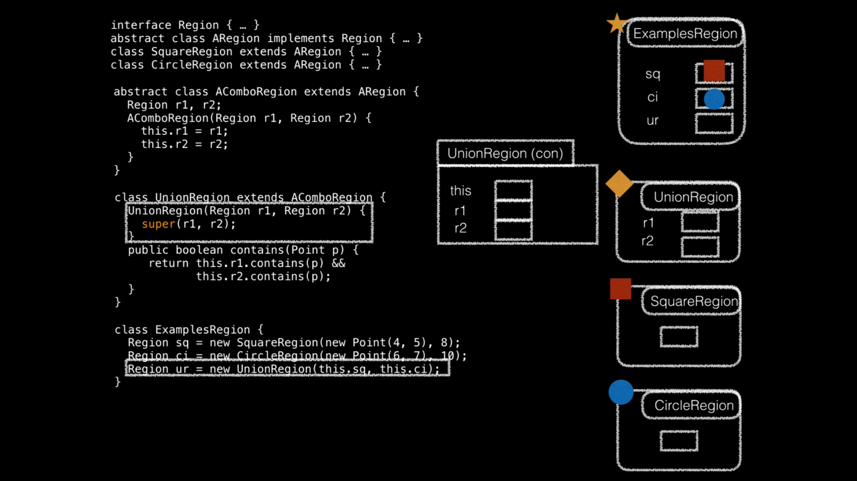

Slide 18
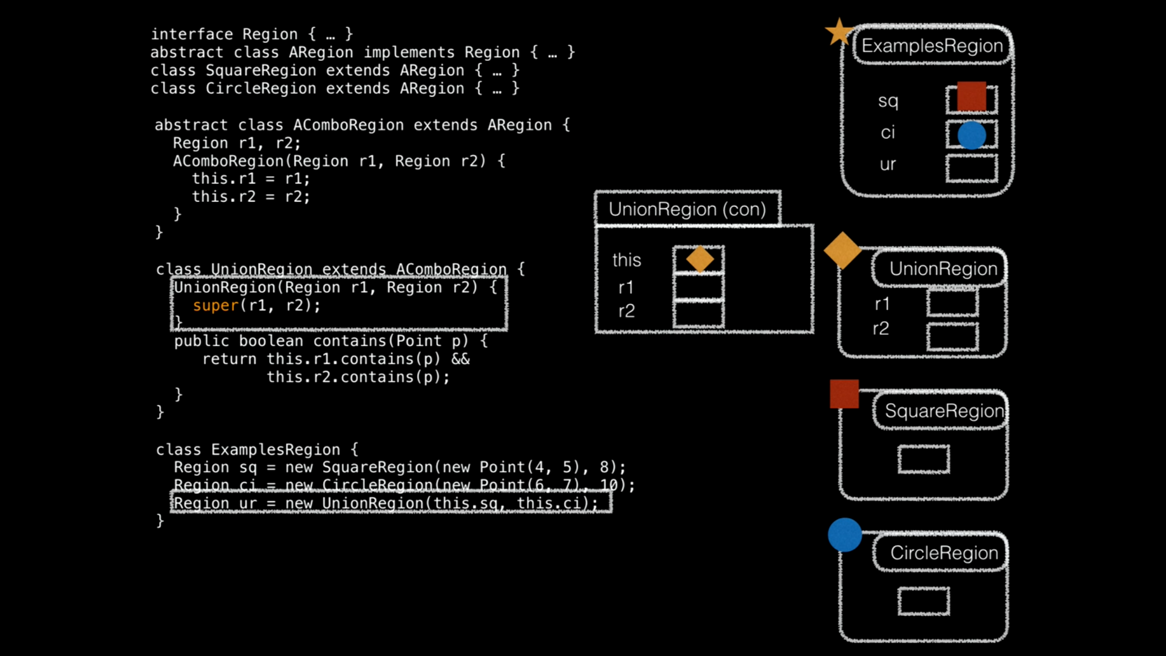

Slide 19
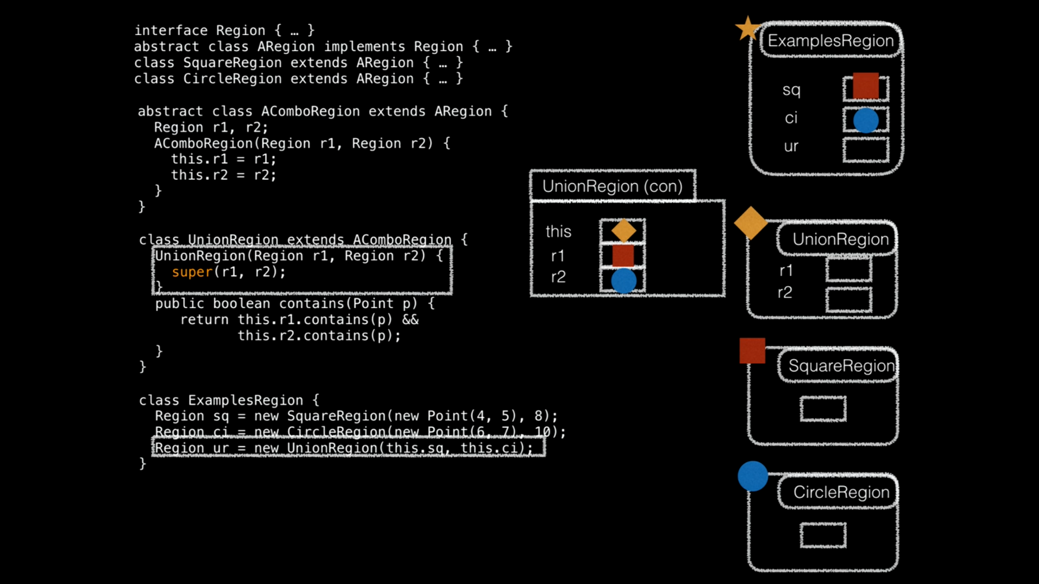

Slide 20
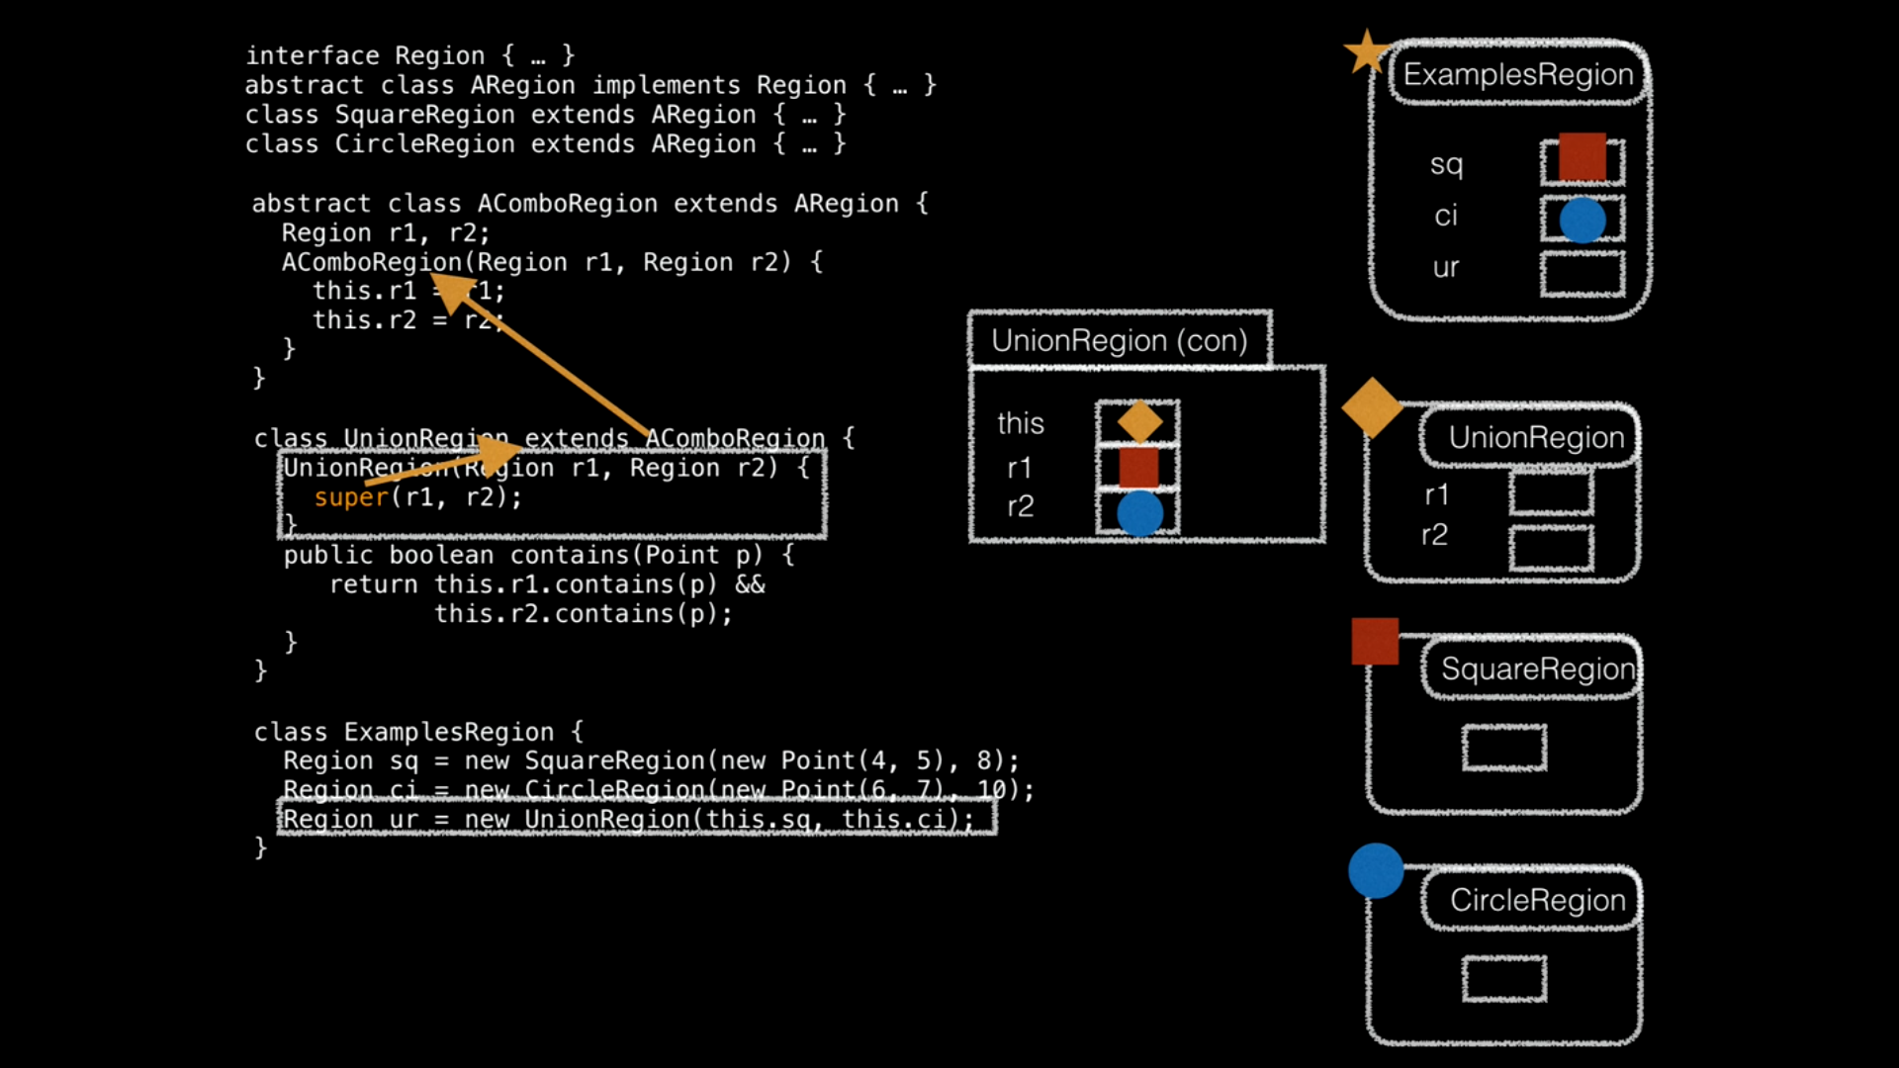

Slide 21
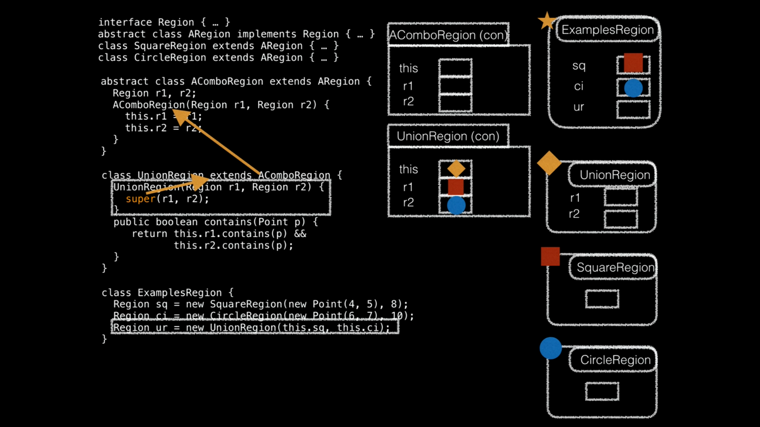

Slide 22
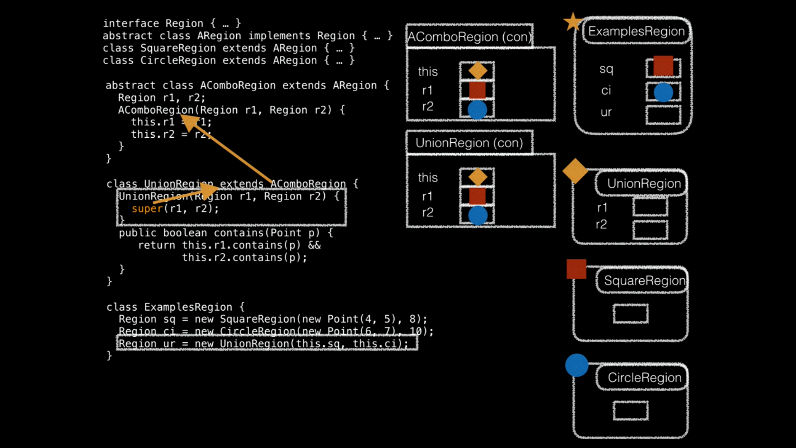

Slide 23
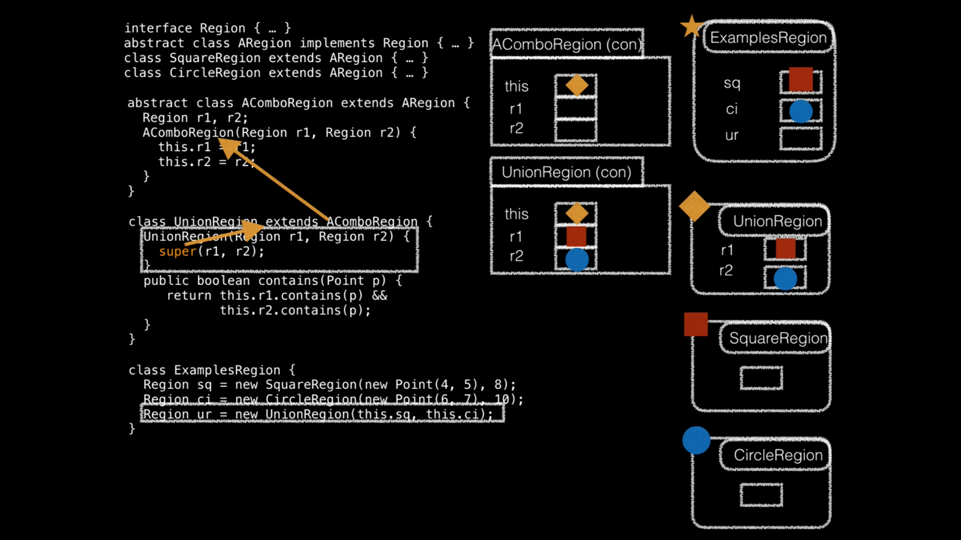

Slide 24
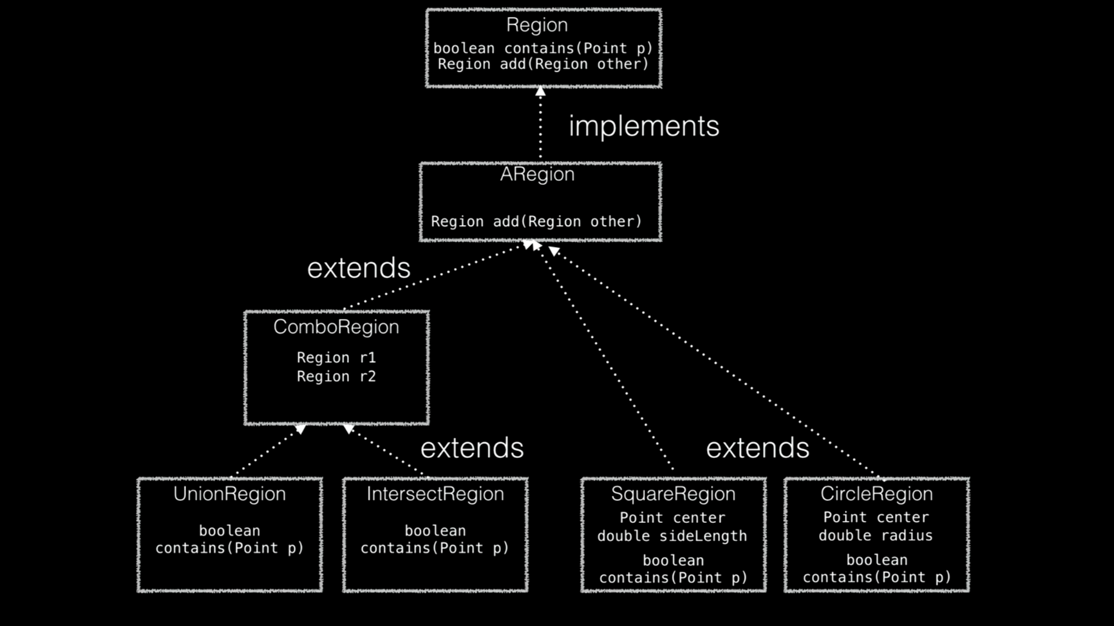


Slide 25
